Slide 1
Arbor - Insights
logo of arbor
A morphologically-detailed neural network simulation library for contemporary high performance computing architectures
12th December 2018 I Alexander peyser & Anne Küsters

Slide 2
Agenda
Insights into Arbor
Introduction
Features
Model
Performance
Hands-on session
Build and run a ring network with python

Slide 3
recent collaborators
Any-one/-group missing (RWTH, BSC), include Wouter, Vasileios
?
From different institutions
Ben Cumming
Stuart Yates
Nora Abi Akar
Vasileios Karakasis
Alexander Peyser
Wouter Klijn
Anne Küsters
openly available @ https://github.com/arbor-sim/arbor

Slide 4
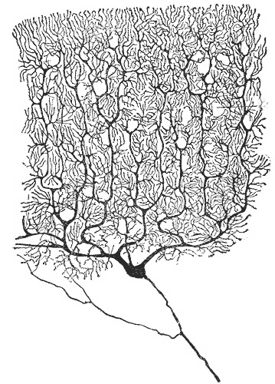
what is arbor?
A morphologically-detailed neural network simulation library for contemporary HPC architectures
A library for the simulation
of large networks of morphologically-detailed, spiking neurons
for all HPC systems in the HBP
Runs on multiple architectures
GPU systems,
vectorized multicore,
Intel KNL and laptops
Modular design for extensibility to new computer architectures
Notes:
Purkinje cell

Slide 5

Why arbor?
FPGAs still supported
?
To solve multi-compartment simulations with large networks on new HPC architectures
Problems and models not explorable with current software and systems, e.g.
Near real-time multi-compartment simulations
Large networks with long simulations, parameter search, statistical validation
Field potential calculations of large networks with volume visualization
Adapting existing simulators to new HPC architectures is hard, e.g. for
Highly parallel architectures such as Intel Xeon and Intel KNL
Wider vector operations such as AVX, AVX2, AVX512
Specialized accelerator hardware as GPUs and FPGAs

Slide 6

Features of Arbor
Aiming for interoperability by being a simulator as library
* available soon
Interoperability Simulator as library
Extensibility Modular internal API
Performance HPC targeted
Multi-physics, i.e. not restricted to neuroscience
Multi-scale from single neurons to large multi-compartmental networks
Visualization (with coupling to in-situ visualization and analysis tools*)
Usability, e.g. installable target and simple configuration, python front-end (as basis for PyNN integration*), efficient sampling of voltage and currents

Slide 7
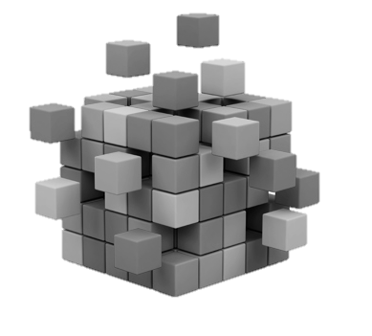
Features of Arbor
Aiming for Extensibility by having modular internal API
* available soon
Interoperability Simulator as library
Extensibility Modular internal API
New integration schemes, (high-order time stepping, error control, and efficient gap junction schemes*)
Custom spike communication and event systems, API for receiving spikes live from external simulators (e.g. NEST*)
Performance HPC targeted
Specialized cells, e.g. leaky integrate-and-fire, Hodgkin-Huxley, Poisson spikes

Slide 8

Features of Arbor
Aiming for high performance on HPC targets
* available soon
Interoperability Simulator as library
Extensibility Modular internal API
Performance HPC targeted
Highly parallel and performance portable with task-based threading implementation, GPU and SIMD vector targets using NMODL and modcc
Design for scalability with fine-grained allocation of CPU and GPU resources
Unit testing, continuous integration as well as validation (and benchmarking suite)
Reporting on memory and energy consumption

Slide 9
Neuron Model
Arbor simulates networks of multi-compartment neurons
Neurons approximated by axonic delay, synaptic functions and a set of cables (as dendrites) connected in a tree.
Cables characterized as 1D electrical compartments (of variable diameter) composed of ion channels, cable resistance and capacitance.
Neuron as sparse, close-to-band matrix to be solved (e.g. by Hines solver) against known current states due to synaptic conductance.
Network and spike exchange between neurons at synapses are represented by concatenations of matrices.

Slide 10
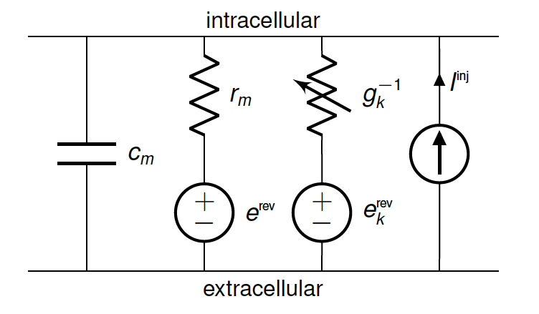
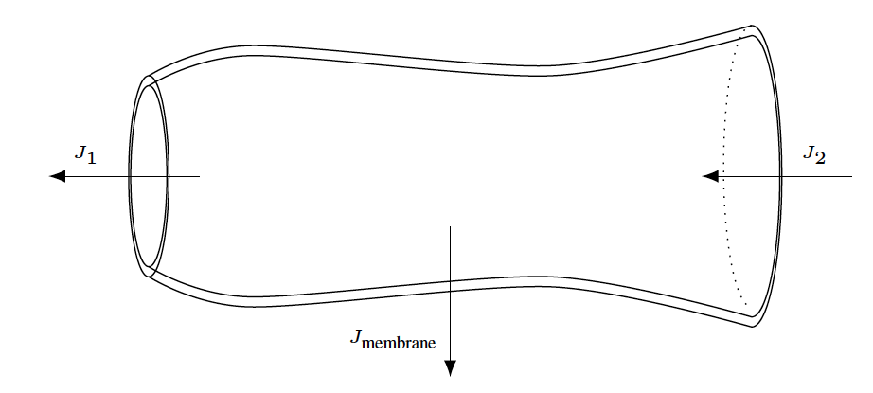
Cable Equation
A cell is modelled as a branching, one-dimensional electrical system
, where
with
Axial conductivity of the intracellular medium
Membrane areal capacitance , areal conductance for an ion channel of type as a function of channel’s state
Corresponding reversal potential
Membrane surface area as a function of axial distance
Current produced by a synapse at position as a function of the synaptic state and local voltage
Injected current at position
Notes:
f_k, f_k^syn biophysical properties of the ion channels and synapses, and will vary from simulation to simulation

Slide 11
Numerical Model
Cell state evolution is numerically solved with first order methods
Space discretization: Vertex-centered 1D finite volume method using first-order approximation for axial current flux with
Voltage and channel state time evolution split: Lie-Trotter
Time discretization: First-order implicit Euler integration
Channel state ODEs: Integration with updated voltages depending on set of ODEs

Slide 12
Cell simulation
Most time consuming on CPU are updating currents and integrating gating variables

Slide 13
Design model
Scalability through the abstraction of recipes
Cells
Recipes
Cell represents smallest model to be simulated
Cell forms smallest unit of work distributed across processes
Types:
Specialized leaky integrate-and-fire cells
Artificial spike sources
Multi-compartment cells
Recipe describes models in cell-oriented manner and supplies methods to
Map global cell identifier gid to cell type
Cell description
List of all connections from other cells that terminate on it
Parallel instantiation of cell data

Slide 14
Design model
Extensibility through cell group abstraction
Cell groups
Mechanisms
Cell group represents collection of cells of same type together with implementation of their simulation
Partitioning into cell groups provided by decomposition
Simulation manages instantiation of model and scheduling of spike exchange as well as integration for each cell group
In a recipe, mechanisms are specifications of ion channel and synapse dynamics
Implementation of mechanism
Hand-coded for CPU/ GPU execution or
A translator (modcc) is used to compile a subset of NEURONs mechanism specification language NMODL to architecture-optimized vectorized C++ or CUDA source

Slide 15
SPIKE EXCHANGE
With minimum delay
Overlapping computation and communication with minimum spike propagation delay
Integration of states in epoch requires spikes from epoch and are exchanged in epoch .
Notes:
epoch: Dt/2

Slide 16
Design model
Programming interface ensures extensibility
Components can be substituted according to internal API.
Models are described in NMODL, a DSL used for the NEURON simulator.
Python interface for building networks under development.

Slide 17
Design model
vector/ GPU included
Computational work is hidden in backends
Cell simulation modules share computational backends for channel and synapse state evolution.
CPU-hosted finite volume cell simulation.

Slide 18
vectorization PERFORMANCE
Used systems and benchmark model
Systems
Benchmark model
Cells: 300 compartments with Hudgkin-Huxley mechanisms, 5.000 randomly connected exponential synapses
Network: 100 cells on single core 1000 cells on socket
Duration: 100 ms
check duration

Slide 19
vectorization Performance
Comparison of explicit vectorization relative to the compiler`s auto-vectorization
Speedup of total time to solution with vectorization
1.5 x for Broadwell socket
3.4 x for KNL socket
Use of data-pattern optimized loads and stores contributes to speedup.
Low improvement for Broadwell due to poor performance of vectorized division.

Slide 20
Performance benchmarks
Setup of ring network on HPC architecture
System
Ring model
Cells: Randomly generated morphologies with on average 130 compartments
Synapses: 10 000 exponential synapses per cell with only one synapse connected to spike detector on preceding cell
Soma: Hodgkin-Huxley mechanism;
Dendrites: Passive conductance

Slide 21
Performance
Single node scaling - time: utilization of computational resources on one node at various model sizes
Models with fewer cells take less time to execute
Scaling is architecture and model size dependent
MC scales well for 64 or more cells
KNL scales well for 512 or more cells
GPU scales well for 1024 or more cells
Below scaling thresholds node resources are under-utilized
GPU catches up at 4000 cells

Slide 22
Performance
Single node scaling – speedup: comparison with NEURON
Memory
Arbor significantly more memory efficient with 4.4 GB for 16k model,
NEURON unable to run 16k model due to running out of 64 GB memory available on Daint-mc
Speedup
Arbor is faster for all model sizes with speedup increasing with model size
5-10x faster for less than 128 cells
over 20x faster for more than 256 cells
Notes:
NEURON
most widely-used software for simulating networks of multi-compartment cells
supports running large models in parallel using multi-threading and MPI
becomes DRAM bandwidth bound, due to the larger model state and because cells are grouped and integrated together in a way that doesn’t retain cell state in cache
ARBOR
smaller models: faster because of a more efficient structure-of-array (SoA) memory layout and vectorization compared to NEURON’s array-of-structure (AoS) layout
larger models: Arbor is optimized to keep cell state in L2 and L3 cache

Slide 23
Performance benchmarks
Setup of connectivity model on HPC architecture
System
10k connectivity model
Cells: As in ring model with 16k cells for duration of 100 ms
Network: 10 000 way randomly connected with no self-connections
Minimal delay: 10 ms or 20 ms
Synapses: All excitatory
Spiking: All cells spike synchronously with frequency 100 Hz or 50 Hz

Slide 24
Performance
Strong scaling: minimizing time to solution for a fixed model size with increasing number of nodes
For less than 4k cells (on 4 nodes) multicore and GPU are equivalent (within 10% range)
For more than 4k cells multicore is faster
A KNL node is uniformly slower than multicore, using 1.4x more time
Still, Arbor can be used effectively on an HPC system available

Slide 25
Performance
Strong scaling efficiency
Resource utilization is effective where strong scaling efficiency is good
Efficiency decreases as the number of nodes increases
Only the multicore system scales with 90% efficiency to 64 nodes (256 cells per node) and minimizes time-to-solution
GPU system is still effective for running large models

Slide 26
Performance
Strong scaling: consumed resources in node-seconds and energy consumption
Notes:
node-second=simulation time x nodes

Slide 27
Performance benchmarks
Setup of dry-run mode on HPC architecture
System
dry-run mode
Model: 100 ms simulation with 10 ms delay and cells firing at 87.5 Hz each cell connected to 10 000 random cells with no self-connection
Mode: Run model on single MPI rank, and mimic running on a large cluster (here: 10 000 nodes) by generating proxy spikes from cells on other ranks
Cells/ node: 1000 & 10 000 cells per node for total model size of 10 M & 100 M cells

Slide 28
Performance
Weak scaling is near perfect
Maximize model size while increasing number of nodes with fixed number of cells
To hundreds of nodes
Arbor weak scales (near) perfectly on multicore and GPU

Slide 29
Performance
Weak scaling sufficient with 80% at extreme scale
To 10 000 nodes
1000 nodes: 1k and 10k models weak scale very well with 99% and 95% efficiency
10 000 nodes: weak scaling still good with 87% and 79% for 1k and 10k models, but decreased due to spike communication and processing

Slide 30
Questions

